Slide 1

Data Structures and its Applications
Dinesh Singh
Department of Computer Science & Engineering

Slide 2

Data structures and its applications
Basic Structure of a Queue , Implementation using an Array
Dinesh Singh
Department of Computer Science & Engineering

Slide 3
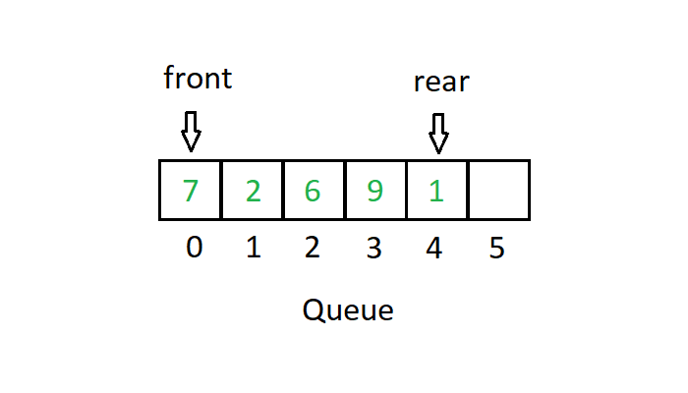
Data Structures and its Applications
Queue Data Structure - definition
A Queue is an ordered collection of items from which items may be deleted at one end ( called the front of the queue )and into which items may be inserted at the other end (called the rear of the queue).

Slide 4
Data Structures and its Applications
Types Queue
Different Types of Queues
Simple Queue
Circular Queue
Priority Queue
Dequeue
Implementation
Sequential Representation ( Arrays)
Linked Representation ( Linked Lists)

Slide 5
Data Structures and its Applications
Queue Operations
Three primitive operations can be applied to the queue
Insert ( q,x) : inserts x at the rear of the queue q
x = remove (q) : deletes front element from the queue and set x to its contents
empty(q) : returns true or false depending on whether the queue contains any elements.
Insert operation cannot be performed if the queue has reached the maximum size.
The result of an illegal attempt to insert an element into a queue which has reached its maximum size is called overflow.
The remove operation can be applied only if the queue is non empty.
The result of an illegal attempt to remove an element from an empty queue is called underflow.
The empty operation is always applicable.

Slide 6
Data Structures and its Applications
Structure of a Simple Queue – Sequential Representation
#define MAXQUEUE 100
struct queue
{
int items [MAXQUEUE];
int front, rear;
} ;
struct queue q;
q.rear = q.front = -1;
Functions to implement the operations
insert ( x, &q)
remove ( &q)
empty(&q)

Slide 7
Data Structures and its Applications
Simple Queue – Insert Operation
Inserting into a queue
Check the queue for overflow condition
If the queue is not in overflow condition, increment the rear pointer and insert the element at a location indicated by the rear pointer.
If this is the first element in the queue, initialise front to 0.
Return 1

Slide 8
Data Structures and its Applications
Simple Queue – Implementation of Insert
int insert(int x,struct queue *q)
{
//check queue overflow
if(q->rear==MAXQUEUE - 1)
{
printf("Queue overflow..\n");
return -1;
}
(q->rear)++;
q->items[q->rear]=x;
if(q->front==-1)//if first element
q->front=0;
return 1;
}

Slide 9
Data Structures and its Applications
Simple Queue – Remove Operation
Removing element from the queue
Check the queue for underflow condition
If the queue is not in underflow condition, remove the element pointed by the front pointer into x.
If this was the only element in the queue, initialise front and rear to -1.
Return x

Slide 10
Data Structures and its Applications
Simple Queue – Implementation of remove
int remove(struct queue *q)
{
int x;
if(q->front==-1)
{
printf("Queue empty..\n");//underflow
return -1;
}
x=q->items[q->front];
if(q->front==q->rear)//only one element in queue
q->front=q->rear=-1;
else
(q->front)++;
return x;
}

Slide 11
Data Structures and its Applications
Simple Queue – Implementation of empty and display
int empty ( struct queue * q)
{
if (q->front ==-1)
return 1;
return -1;
}
display (struct queue * q)
{
int i;
if(q->front==-1)
printf(”Empty queue..\n”)
else
{
for ( i = q->front; i<=q->rear;i++)
printf(”%d”,q->items[i]);
}
}

Slide 12
Data Structures and its Applications
Simple Queue – Another Implementation
Implementation where queue represented as an array , front and rear are separate variables
#define MAXQUEUE 100
int q[MAXQUEUE]
int front, rear
front = rear = -1
Function calls to implement the operations
insert( x, q, &front, &rear) ;
remove (q , &front, &rear);
empty( q, &front)

Slide 13
Data Structures and its Applications
Simple Queue – Another Implementation
Implementation where queue represented as an array , front and rear are separate variables
int insert(int x,int *q,int *f,int *r)
{
//check queue overflow
if(*r==MAXQUEUE - 1)
{
printf("Queue overflow..\n");
return -1;
}
(*r)++;
q[*r]=x;
if(*f==-1)//if first element
*f=0;
return 1;
}

Slide 14
Data Structures and its Applications
Simple Queue – Another Implementation
Implementation where queue represented as an array , front and rear are separate variables
int remove(int *q,int *f,int *r)
{
int x;
if(*f==-1)
{
printf("Queue empty..\n");
return -1;
}
x=q[*f];
if(*f==*r)//only one element in queue
*f=*r=-1;
else
(*f)++;
return x;
}

Slide 15
Data Structures and its Applications
Simple Queue – Another Implementation
Implementation where queue represented as an array , front and rear are separate variables
display (int *q, int f, int r)
{
int i;
if(f==-1)
printf(”Empty queue..\n”)
else
{
for ( i = f; i<= r; i++)
printf(”%d”,q[i]);
}
}

Slide 16
THANK YOU
Dinesh Singh
Department of Computer Science & Engineering
dineshs@pes.edu
+91 8088654402

